Slide 1
CTE Research Network Practitioner Training Modules: Understanding and Using CTE Data and Research
Educating for Careers Conference
February 28, 2022
Notes:
Brief intros for all

Slide 2
Welcome
Cherise Moore, PhD
Principal Technical Assistance Consultant
American Institutes for Research
Tara Smith
Associate Research Director
Jobs for the Future, Inc.
Pradeep Kotamraju, PhD
Dep. Director, Policy, Research and Legislation
California Workforce Development Board
Notes:
All

Slide 3
CTE Research Network
Mission
To expand the evidence base on the impact of career and technical education (CTE) programs on student outcomes by:
Increasing the number of CTE impact studies performed.
Increasing the pipeline of new CTE researchers.
Strengthening field capacity to conduct and use rigorous CTE research.
3
Notes:
Tara
The work of the CTE research network is to expand the evidence base on the impact of CTE programs on student outcomes and to expand the pipeline of CTE researchers, and build capacity in the field to engage in rigorous research.
This training series was developed by the CTE Research Network. The CTE Research Network is supported by the Institute of Education Sciences at the U.S. Department of Education with funds provided under the Carl D. Perkins Career and Technical Education Act through Grant R305N180005 to the American Institutes for Research (AIR). Network activities are directed toward increasing the number of CTE impact studies and strengthening the capacity of the field to conduct and use rigorous CTE research. AIR and its partners—the Association for Career and Technical Education (ACTE), JFF, and Vanderbilt University—serve as the CTE Research Network Lead.

Slide 4
CTE Research Network Lead
$5 million, five-year grant from the Institute of Education Sciences, U.S. Department of Education (Grant # R305N180005) to the American Institutes for Research; partners are the Association for Career and Technical Education, Jobs for the Future, and Vanderbilt University
The Network includes six research teams conducting causal CTE studies (NYC CTE; P-TECH; NC Career and College Promise; CT Technical High Schools; Tech Advising Tools; Virtual Enterprises)
Notes:
Tara
The CTE Research Network is a five-year initiative of the American Institutes for Research, Jobs for the Future, the Association for Career and Technical Education, and Vanderbilt University.
The network includes six research study teams leading causal research on Career and Technical Education in New York City, Connecticut, North Carolina, and on CTE models like P-TECH and Virtual Enterprises. One study is looking at how technology-based advising tools impact CTE student pathways.

Slide 5
CTE Research Network Activities
Notes:
Tara
The purpose of the CTE Research Network is to:
1) increase the evidence base about the impact of CTE programs and policies on student outcomes, and
2) increase the pipeline of new CTE researchers.
Also:
To better coordinate the CTE field around disseminating, understanding, and using causal research
To bring CTE practitioners and researchers together to better share and understand research needs

Slide 6
Practitioner Training Modules
Purpose: To support practitioners and policymakers in understanding and using data and research, particularly causal research
Audiences: State and district CTE practitioners and policymakers—anyone who can use data and research to inform decision making and support continuous improvement efforts
Notes:
Cherise
Our main mission is to expand the evidence base and, related to that, to bring CTE practitioners and researchers together to better share research and understand research needs. Research can be used in so many ways—to inform policy, to understand program effects, and to drive program improvement. But practitioners do not necessarily have a research background. We want to support practitioners in understanding and using not just research but causal research.
Training in best practices for data collection and organization can help to improve data systems, and training in research methods can support practitioners’ use of data and research to inform state and local programming decisions.

Slide 7
Who is in the room?
Your role
Teacher
Administrator/Director
Counselor
Other
Notes:
Cherise
So, instead of zoom polls, we are going old school with raising hands

Slide 8
Who is in the room?
Experience/Time in CTE
0-3 years
4-6 years
7-9 years
10+ years
Notes:
Cherise

Slide 9
Who is in the room?
CTE Research Integration
Never
Rarely
Sometimes
Frequently
Notes:
Cherise

Slide 10
Turn and Talk
What are some things that come to mind when you consider CTE and Research?
Notes:
Cherise
Before we go into detail about what the training modules are, we want to get your thoughts on what comes to mind when you consider CTE and Research.
What do you think about? What exists? What’s missing? Why does it matter?

Slide 11
Practitioner Training Modules
Understanding CTE Data and Why It Matters
Using Data and Research to Improve CTE Programs
CTE Program Evaluation: Why It Matters to Practitioners
Using State Data to Partner With Researchers
Using Research to Design Your CTE Program for Equity
How to Communicate About Your CTE Program Using Research
https://pixabay.com/photos/home-office-workstation-office-336377/
11
Notes:
These are the six modules we are developing.
This series of six modules is designed to support CTE educators in learning more about data and research.
Although the modules need not be viewed sequentially, we suggest that you consider doing so if you plan to complete the entire series.

Slide 12
Importance of Research for CTE Teachers and Local Administrators
Notes:
Pradeep

Slide 13
Why important to distinguish between data, reporting, accountability, and evaluation?
Data: collecting for entry into a receptacle (Module 1)
Reporting: making observations and inferences (Modules 1, 2, 6)
Accountability: Setting out a continuous improvement process (Modules 1, 2, 5)
Evaluation: How well is my program doing and is my program working (Modules 1, 3, 4)
Notes:
Distinguishing research into its components parts
How do each relate to the modules
Data: explain receptacle
Reporting: structured presentation
Accountability: moving beyond compliance
Evaluation: combines efficiency and effectiveness

Slide 14
If you are teacher…..
Data: Collected at different points of a student’s progression…
Reporting: aggregating student data as a whole make observations, inferences…
Accountability: benchmarking yourself for continuous improvement….
Evaluation: using objective criteria, asking yourself is my program working?
Notes:
What modules teach you…
Focus on the student and class (the unit of analysis)
There is a sequencing process that is critical for research
As a teacher do data reporting and evaluation

Slide 15
If you are a local administrator…..
Data: collected for different classes or different levels of student disaggregation…
Reporting: class-level data comparison as a whole make observations, inferences…
Accountability: benchmarking district/college for continuous improvement….
Evaluation: using objective criteria, asking yourself is my program working?
Notes:
What modules teach you…
Focus on the program/class (the unit of analysis)
There is a sequencing process that is critical for research
As an administrator do data reporting and evaluation
If resources available, engage in an evaluation

Slide 16
Looking at CTE Research Holistically
Making the case for…
an individual class/program for continuous improvement/resource allocation
a targeted funding for particular groups of students
marketing and promotion
developing resources for program assessment (CLNA, CTEIG self-evaluation)
the submission for fulfilling state and federal accountability requirements
an objective evaluation of why “my” CTE program works
the return on investment for CTE at the class/program/district/state levels
Notes:
Go over slide and also talk about CTE Online

Slide 17
The Modules

Slide 18
Module Components
Each module contains:
PowerPoint slides,
Handouts and activities, and
A facilitator’s guide
Each self-contained module can be delivered online, in-person, in a group setting, or individually.
A glossary of terms will accompany the modules.
Notes:
Each module can be completed in 45 minutes to an hour.
The modules are self-contained, but they do build in complexity and later modules draw from terminology and definitions in the earlier ones.
In the next several slides, we will share with you the objectives for each of the six modules.

Slide 19
Module 1: Understanding CTE Data and Why It Matters Objectives
Answer fundamental questions about data and research for CTE programs.
Connect data to Perkins V requirements.
Define evidence-based research, understand why it is important, and where to find it.
Understand real-world examples of CTE data and research.
https://pixabay.com/illustrations/brain-think-human-idea-20424/
19
Notes:
Understanding CTE Data and Why It Matters
After viewing this module, you should be able to better understand what CTE data are and how research can be used to improve CTE programs. You also will be able to connect data to federal accountability requirements contained with the Strengthening Career and Technical Education for the 21st Century Act, also referred to as Perkins V. In addition, you will be able to define what evidence-based research is, understand why it is important, and know where to find it. Real-world examples are offered to help you connect theory to practice.

Slide 20
Module 2: Using Data and Research to Improve CTE Programs Objectives
Understand how data and research are used to improve CTE programs.
Learn how to access and use research relevant to CTE programs.
Learn about the continuous improvement model as it applies to CTE.
Consider short-term versus long-term program planning.
Understand real-world examples.
https://pixabay.com/photos/reading-glasses-book-read-4330761/
20
Notes:
Using Data and Research to Improve CTE Programs
After viewing this module, you will have a better understanding of how data and research can be used to improve CTE programs, and how to access this information. You also will learn how a continuous improvement process can be launched---with consideration given to short- and long-term planning---and will be provided with real-world examples and tested tools to undertake this work.
Educators should rely on data and evidence-based research to guide their continuous improvement efforts. This module describes a structured, iterative continuous improvement process that educators can follow to apply the data and research they collect.
Continuous improvement, a process of implementing and monitoring ongoing feedback, is an important component of creating and maintaining successful CTE programs. For practitioners to engage in continuous improvement – and to use data and research to go beyond accountability – they need to maintain an effective data collection system for decision making and make data-based decisions that lead to equity and improvement for all students.
Although there are many improvement frameworks that exist, this module introduces the Plan-Do-Study-Act process. Although conceptually simple, this four-step process requires careful and thoughtful planning. Its components include:
Plan: Determine what it is you are seeking to accomplish and how you will assess your result.
Do: Design and implement your proposed improvement plan.
Study: Collect and analyze data and review the research to help contextualize your results.
Act: Use the result of your analysis to fine-tune your engagement.
We will look at Module 2 in greater detail.

Slide 21
Module 3: CTE Program Evaluation: Why It Matters to Practitioners Objectives
Define impact and what it means to have an impact.
Explain the difference between performance measures and program evaluation.
Explain why program evaluation is valuable for CTE programs.
Understand the different types of evaluation and their purpose.
Learn what a logic model is and how to use one to assess program outcomes.
Identify best practices in program evaluation.
https://pixabay.com/photos/target-goal-aiming-dartboard-aim-1551492/
21
Notes:
CTE Program Evaluation: Why It Matters to Practitioners
Upon completion of this module, you will be able to define educational impact and what it means to have an impact in CTE. You will understand the different performance measures and program evaluations, be able to explain why program evaluation is valuable for CTE programs, and understand the different types of evaluations and their purposes. Finally, you will learn what a logic model is and how to use one to assess program outcomes. Examples of best practices in program evaluation also will be provided to help you in undertaking your own evaluation efforts.

Slide 22
Module 4: Using State Data to Partner With Researchers Objectives
Why states should consider partnering with researchers
How to include CTE data in accountability systems and state longitudinal data systems
How states can partner with researchers
Real-world examples that showcase how research partnerships can work and the benefits they confer
https://cdn.pixabay.com/photo/2016/11/03/11/57/accountant-1794122_960_720.png
22
Notes:
Using State Data to Partner With Researchers
Upon completion of this module, you will be able to describe why states should partner with researchers and understand how to include CTE data in your state’s accountability systems and state longitudinal data systems. You also will be able to explain how states can partner with researchers and have greater comprehension of real-world examples that showcase how partnerships can work and the benefits they confer.

Slide 23
Module 5: Using Research to Design Your CTE Program for Equity Objectives
Define special populations.
Identify underperforming student subgroups.
Explain the implications of a local equity gap analysis.
Understand and apply what the research says about equity in CTE.
Use the Perkins V data disaggregation requirement to improve equity outcomes.
Explain the difference between equitable access and equitable outcomes.
Determine best practices for closing the CTE opportunity gap and ensuring equity in your CTE programs.
https://mk0deeperlearnihq2vs.kinstacdn.com/wp-content/uploads/2020/07/AMERICANED_UCLACOMM_044.jpg
Notes:
Using Research to Design Your CTE Program for Equity
After viewing this module, you will have a better understanding of how research can be used to improve equity in CTE programs. You also will learn about concepts of equity in Perkins V as they relate to special populations of students. You will be able to identify underperforming student subgroups and explain the implications of a local equity gap analysis. Importantly, you will be positioned to understand and apply what the research says about equity in CTE.
Accordingly, equitable access involves providing all students, regardless of their special population status, with options that allow them to participate in CTE programming. This begins with ensuring that all students have access to a full range of high-quality CTE programs. For example, CTE classrooms should be accessible to all students, irrespective of their special population status. This could mean making adjustments; for example, providing wheelchair ramps to ensure that the physically handicapped are not prevented from participating. Similar logic would apply to program recruitment and admission policies to ensure that they do not discriminate against students. For example, if recruitment efforts consist of flyers on bulletin boards or websites written only in English, then individuals with limited English skills may be unaware of the opportunity. Counseling practices also must be designed to ensure that all students are provided equitable access to services. Also, all students must have access to participate in programs that prepare them for high-wage, high-skill, in-demand careers. This means that students should not be sorted into different programs based on their gender, race/ethnicity, or special population status.

Slide 24
Module 6: How to Communicate About Your CTE Program Using Research Objectives
Learn how to communicate your CTE program’s value and research findings to different audiences and stakeholders.
Understand real-world examples of types of communication.
https://research.steinhardt.nyu.edu/site/research_alliance/2020/04/15/who-chooses-career-and-technical-education-in-nyc/
24
Notes:
How to Communicate About Your CTE Program Using Research
By the end of this module, you will have learned strategies for communicating research findings to different audiences and stakeholders to publicize your CTE program’s value. You also will understand techniques for communicating instructional benefits based on real-world examples.

Slide 25
Think, Pair, Share
Of these modules, if you had to take just one, what would it be and why?
Notes:
Ok, so most of you want to know about XXX…that’s great.
We will show you where to find that module by the time we finish the training.
In the meantime, we selected Module 5 on equity to go deeper on in the next section.

Slide 26
Using Research to Design Your CTE Program for Equity
Training Module Series #5
Notes:
[share facilitators guide]
High-quality career and technical education, often referred to as CTE, can prepare students to succeed in postsecondary education and careers. This module is designed to support school district and college CTE program administrators in understanding CTE data and how best to use them.

Slide 27
Module Contents
Defining Key Terminology
Equity in CTE Student Subgroups and Special Populations
Equitable Access and Outcomes
What the Research Says About Equity in CTE
Best Practices to Close the CTE Opportunity Gap
https://pixabay.com/photos/checklist-list-ticked-off-hook-2945401/
Notes:
This module will help you learn about how you can use research to design CTE programs to promote equity. You will gain an understanding of the student groups identified in the federal Strengthening Career and Technical Education for the 21st Century Act, also known as Perkins V, and how to use data to ensure that these students are served. We will define the opportunity gap in the context of CTE and clarify the distinction between equitable access and equitable outcomes. Finally, we will examine lessons learned from the literature on equity in CTE and identify best practices for closing the opportunity gap in your site.
Activities are provided throughout this module to help you think about how you might begin to close the opportunity gap at your site.

Slide 28
Module Instructions
This module includes processes, activities, and tools you can use to drive change at your site.
Before you begin, we recommend downloading and printing the activity worksheets to help contextualize your viewing
Notes:
This interactive module is intended to provide you with processes and tools to help you improve equity in career and technical education programming at your site. To help contextualize your experience, activities are provided to help you gain an understanding of how you may use the tools provided to implement change.
Before you begin viewing the module, we recommend that you download and print the activity worksheets and active use them to apply your learnings.

Slide 29
Activity 1: Opening Self-Reflection
Think about the students enrolled at your site and the extent of their participation in CTE programming.
Answer the questions included in the reflection activity worksheet provided
Restart the module when you have completed the worksheet
https://pixabay.com/illustrations/question-mark-question-mark-sign-1722862/
Notes:
(5 min) To help frame your module engagement, please think about the students enrolled at your site and the extent of their participation in CTE programming. Stop the module and follow the directions on the “Self-Reflection Activity” worksheet.
Note: For asynchronous professional learning using the module, please download or print out the worksheets before you start the module. For facilitated in-person professional learning, this opening reflection question activity should be done as a 5-minute think-pair-share.

Slide 30
Defining Key Terminology
Notes:
To use research to design your CTE program for equity, it is important that you be aware of some key terminology. The next five slides review key terms used throughout this module. You may wish to download the module glossary that includes these terms and other terms related to using data and research to help inform your work.

Slide 31
Nontraditional Fields
An occupation or field of work for which individuals from one gender comprise less than 25 percent of the individuals employed in that occupation or field.
Source: Perkins V, Section 5.
https://mk0deeperlearnihq2vs.kinstacdn.com/wp-content/uploads/2020/07/AMERICANED_UCLACOMM_047.jpg
Notes:
CTE programs are intended to serve all students. However, in the workforce, some occupations or fields of work are dominated by either males or females. A nontraditional field is one in which individuals from one gender comprise less than 25% of the individuals employed in that occupation or field. For accountability purposes, states are required to collect data on CTE concentrators in CTE programs and programs of study that lead to employment in nontraditional fields.
Nontraditional careers refers to occupations or fields of work, including careers in computer science, technology, and other emerging high-skill occupations; in which individuals from one gender comprise less than 25% of the individuals employed in an occupation or field of work.

Slide 32
CTE Opportunity Gap
The opportunity gap refers to racial, gender, and income disparities and inequities in access to and participation in high-quality CTE programs.
https://live.staticflickr.com/4069/4534362371_3da9090e51_b.jpg
Notes:
For students to take full advantage of CTE programs, states and districts must address racial, gender, and income inequities that may affect their participation and/or persistence in coursework. High-quality CTE programs are designed with equity in access and opportunity as a central goal.
For example, schools located in communities with higher socioeconomic status may have relatively more well-resourced CTE programs or be more likely to offer CTE programming in high-wage, high-demand fields. If so, this may lead to inequitable access to services, where some students are more likely to benefit from specific high-wage, high-demand programming than students in schools that primarily serve historically disadvantaged students. To address this inequity, states and/or districts may act to equalize student access to CTE by allocating resources relative to district and/or school need so that all students have equitable access to programs. In doing so, they help prepare students for the future, giving them greater flexibility to pursue career opportunities after high school.

Slide 33
Equity in CTE Student Subgroups and Special Populations
Notes:
In this section, you will gain an understanding of the subgroups and special populations identified within Perkins V and become familiar with sources to access national data on CTE students and the outcomes they achieve. As a reminder, you may download the module glossary that includes the list of special populations along with other terms used throughout the module.

Slide 34
Equity Requirements under Perkins V
Local CTE providers must undertake a Comprehensive Local Needs Assessment (CLNA) to evaluate student performance with the goal of:
Identifying strategies to overcome barriers that result in lowering rates of access to, or performance gaps in, the courses and programs for special populations
Providing programs that are designed to enable special populations to meet the state or local targets for performance
Offering activities to prepare special populations for high-skill, high-wage, or in-demand industry sectors or occupations
Source; National Alliance for Partnerships in Equity (2018b)
https://www.napequity.org/nape-content/uploads/NAPE-Perkins-V-Equity-Provisions-Summary_Final_10-15-18_ml.pdf
https://pixabay.com/photos/reading-law-study-student-homework-4620776
Notes:
Equity is a cornerstone of the federal Perkins V legislation. The act requires that state and local CTE grant recipients take steps to reduce or eliminate equity gaps that exist across student subgroups, including gender and race/ethnicity, as well as for students who are members of special population groups.
While the act includes numerous requirements to motivate improvement, perhaps one of the most compelling is the expectation that providers undertake a Comprehensive Local Needs Assessment, often referred to as a CLNA, every two years. The CLNA is developed by local program providers to determine the CTE services they should plan to offer.
Among the activities in which CTE administrators must engage is an evaluation of the performance of the students on the federal accountability indicators. The goals of this evaluation are (1) identifying strategies to overcome barriers that result in lowering rates of access to, or performance gaps in, the courses and programs for special populations; (2) providing programs that are designed to enable special populations to meet the local levels of performance; and (3) offering activities to prepare special populations for high-skill, high-wage, or in-demand industry sectors or occupations in competitive, integrated settings that will lead to self-sufficiency” (NAPE, 2018b, p. 5).

Slide 35
Who are Special Populations under Perkins V?
Individuals with disabilities
Individuals from economically disadvantaged families, including low-income youth and adults
Individuals preparing for non-traditional fields
Single parents, including single pregnant women
Out-of-workforce individuals
English learners
Youth who are in, or have aged out of, the foster care system
Youth with parents on active duty in the armed forces
Homeless individuals
Source: Advance CTE and Association for Career and Technical Education (2018)
Notes:
Special populations defined within Perkins V are the same as those stipulated in previous legislation with the addition of three new categories: out-of-workforce individuals (formerly defined as displaced homemakers), youth with parents on active duty in the armed forces, and homeless individuals.

Slide 36
What the Research Says About Equity In CTE
Notes:
In this section, we will review what the research says about equity in CTE and consider how you might use this information to conduct a gap analysis.

Slide 37
Highlights from Recent Research Related to Equity in CTE (continued)
“Earning a credential is associated with an increase in the probability of graduating from high school on time in Florida, Indiana, and Kentucky. This effect is stronger for female CTE students as compared to male CTE students.”
“The positive effects of earning a credential on postsecondary outcomes were stronger for students who were not low-income. A possible explanation is that low-income and non-low-income students are earning different credentials.”
- Walsh, O’Kane, Noronha, & Taska (2019), p. 5
https://www.burning-glass.com/wp-content/uploads/credentials_meet_market_report.pdf
Notes:
In a 2019 study of the effect of high school industry credentials on the educational and labor market outcomes of students in three states, Walsh and colleagues found that earning a credential was associated with an increase in the probability of graduating, and that this effect was stronger for female CTE students than for male CTE students. Results for postsecondary enrollment were less promising for low-income students. Those earning a credential were somewhat less likely to graduate high school on time, enroll in community college, and complete community college after enrolling. These results, while unexpected, may be associated with the type of credential earned, be it in the specific field or the cost associated with taking the exam, which some lower income students may be unable to afford. This suggests the need for continued research in the field to fully explore these equity considerations.

Slide 38
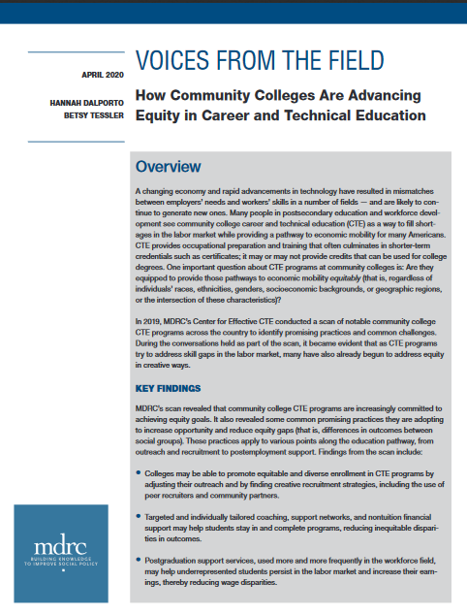
Highlights from Recent Research Related to Equity in CTE (continued)
“Colleges may be able to promote equitable and diverse enrollment in CTE programs by adjusting their outreach and finding creative recruitment strategies, including the use of peer recruiters and community partners.”
“Targeted and individually tailored coaching, support networks, and nontuition financial support may help students stay in and complete programs, reducing equity gaps.”
Source: Dalporto & Tessler (2020), p. 1
https://www.mdrc.org/sites/default/files/Equity_in_CTE_brief.pdf
Notes:
In a scan of notable community college CTE programs offered nationwide, MDRC’s Center for Effective CTE noted a number of promising practices to promote equity. For example, it was found that colleges were able to propose a more equitable and diverse enrollment in CTE programs by adjusting their outreach and finding creative recruitment strategies. Targeted and individualized coaching, support networks, and nontuition financial support also proved to be promising practices in retaining diverse students and, in so doing, helped to reduce equity gaps.

Slide 39
Best Practices to Close the CTE Opportunity Gap
Notes:
And finally, let’s put together the equity issues we’ve identified and the strategies we’ve learned to start thinking about how to begin to close the CTE opportunity gaps we are facing.

Slide 40
Think, Pair, Share
Think about whom you are engaging—local CTE and education and workforce pipeline stakeholders? Teachers, counselors, advisors? Career center and community college staff?
Think about how you are engaging: what language are you speaking and what languages are stakeholders speaking? Are you scheduling meetings when some stakeholders are unable to attend? Are you issuing media some stakeholders cannot use?
Notes:
Think about whom you are engaging—local CTE and education and workforce pipeline stakeholders? Teachers, counselors, advisors? Career center and community college staff?
Think about how you are engaging: what language are you speaking and what languages are stakeholders speaking? Are you scheduling meetings when some stakeholders are unable to attend? Are you issuing media some stakeholders cannot use?
Also think about whom stakeholders trust (e.g., school counselors, teachers, and CTE students) and enlist them as champions (Estes &McCain, 2019, p. 13).
Consider the following (Advance CTE, 2019a, p. 1):
“1. Acknowledge that inequity is a problem.
2. Promote a culture that values equity and diversity within the state agency and instructor workforce.
3. Commit to transparency and advancing only high-quality CTE programs of study,
4. Implement strategies to gain buy-in from communities and stakeholders.
5. Celebrate, lift up, and replicate successful programs of study and practices.”

Slide 41
Best Practices to Address Inequities
Engage stakeholders by….
Setting up a diverse cross-functional team
School leadership and staff
CTE community members
Building trust with students and families
Take steps to minimize language barriers with families
Align your feedback timeframe and delivery methods with stakeholders’ diverse needs
Sources: Advance CTE (2019a); Estes & McCain (2019), Williams (2016)
Notes:
Think about whom you are engaging—local CTE and education and workforce pipeline stakeholders? Teachers, counselors, advisors? Career center and community college staff? (Williams, 2016, p.21)
Think about how you are engaging: what language are you speaking and what languages are stakeholders speaking? Are you scheduling meetings when some stakeholders are unable to attend? Are you issuing media some stakeholders cannot use? Also think about whom stakeholders trust (e.g., school counselors, teachers, and CTE students) and enlist them as champions (Estes &McCain, 2019, p. 13).
Consider the following (Advance CTE, 2019a, p. 1):
“1. Acknowledge that inequity is a problem.
2. Promote a culture that values equity and diversity within the state agency and instructor workforce.
3. Commit to transparency and advancing only high-quality CTE programs of study,
4. Implement strategies to gain buy-in from communities and stakeholders.
5. Celebrate, lift up, and replicate successful programs of study and practices.”

Slide 42
Closing Reflection and Resources
Notes:
Congratulations on completing Model 5: Using Research to Design Your CTE Program for Equity. We hope that this module has helped to strengthen your understanding of equity in CTE and how to include an equity lens in your program.

Slide 43
Activity 4: Beginning the Journey
What are three strategies that you can apply from the research on equity in CTE to improve access, opportunity and outcomes for your nontraditional special population students?
Answer the questions included in the reflection activity worksheet provided
Restart the module when you have completed the worksheet
https://pixabay.com/illustrations/question-mark-question-mark-sign-1722862/
Notes:
To help close out your module engagement, please consider how you might use the information contained in this module to identify three strategies that you can apply from the research on equity in CTE to improve access, opportunity, and outcomes for your nontraditional special population students at your site. Stop the module and follow the directions on the “Beginning the Journey” worksheet.
For asynchronous professional learning using the module, please download or print out worksheets ahead of starting the module. For facilitated in-person professional learning, this closing reflection question activity should be done as a 5-minute think-pair-share.

Slide 44
References and Resources
Advance CTE (2019a). Making Good on the Promise: Building Trust to Promote Equity in CTE. Silver Spring, MD: Author. Retrieved August 28, 2020 from https://careertech.org/resource/building-trust-promote-equity-cte
Advance CTE (2019b). Making Good on the Promise: Expanding Access to Opportunity. Silver Spring, MD: Author. Retrieved August 28, 2020 from https://careertech.org/resource/expanding-access-opportunity
Advance CTE (2020, June 22). A Learner-Centered Approach to Early Postsecondary Opportunities Amid COVID-19. COVID-19 CTE. http://blog.careertech.org/?p=16693
Advance CTE and Association for Career and Technical Education (2018). Legislative Summary & Analysis - Strengthening Career and Technical Education for the 21stCentury Act (Perkins V). Silver Spring, MD and Alexandria, VA: Authors. Retrieved from https://www.acteonline.org/wp-content/uploads/2018/08/AdvanceCTE_ACTE_P.L.115-224Summary_Updated080618.pdf
Dalporto, H., & Tessler, B. (2020). Voices from the Field: How Community Colleges Are Advancing Equity in Career and Technical Education. New York, NY: MDRC. Retrieved August 27, 2020 from https://www.mdrc.org/sites/default/files/Equity_in_CTE_brief.pdf

Slide 45
Wrap-Up

Slide 46
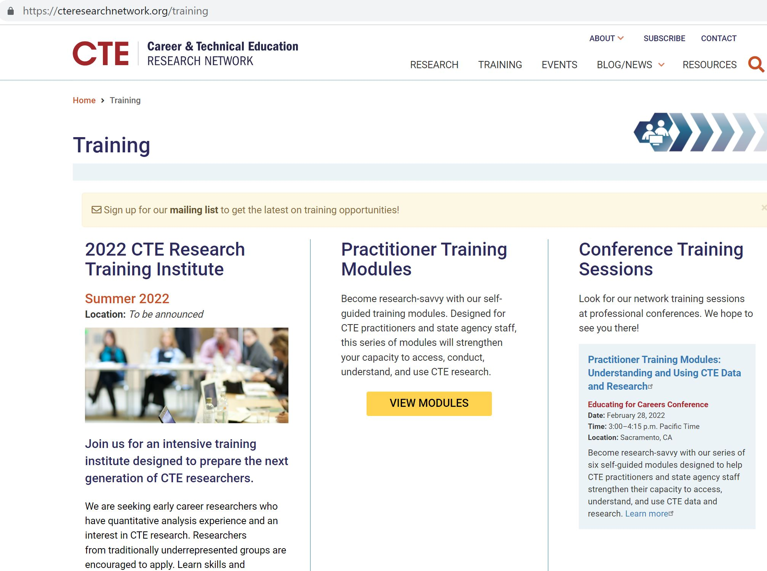
How to Find the Practitioner Training Modules
The CTE Research Network website: https://cteresearchnetwork.org/training

Slide 47
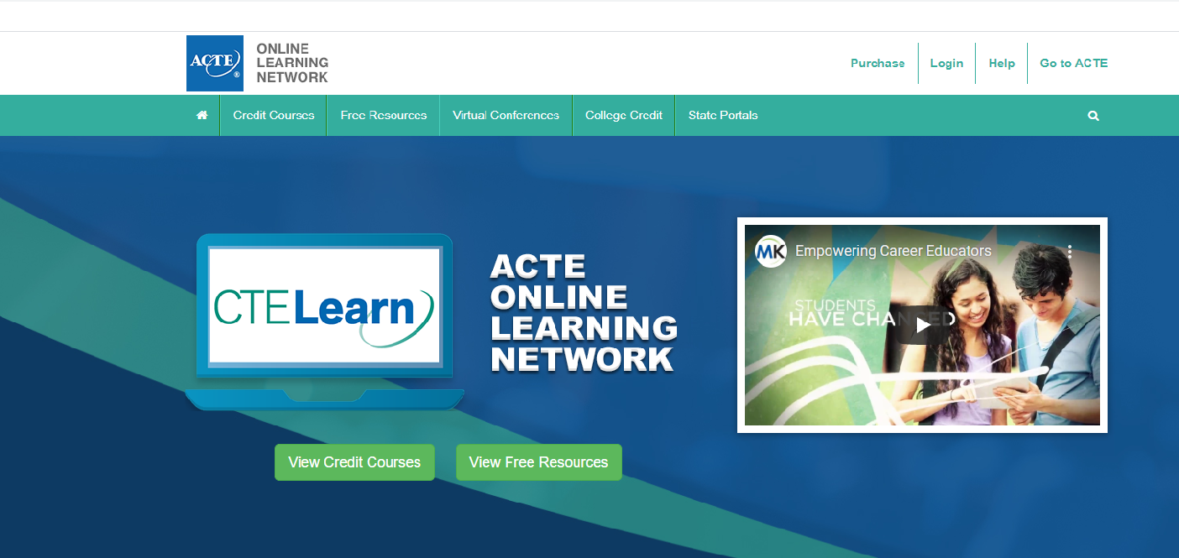
How to Find the Practitioner Training Modules
ACTE website: https://www.ctelearn.org/

Slide 48
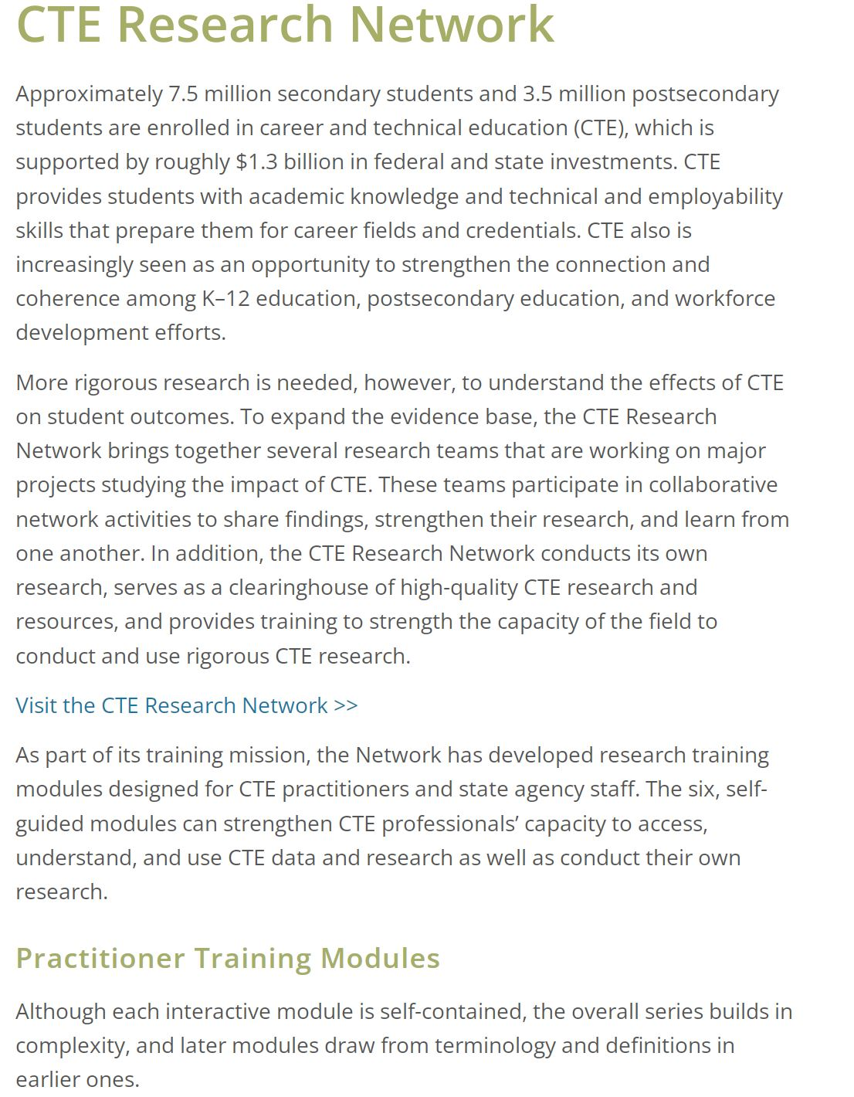
How to Find the Practitioner Training Modules
PCRN site: https://cte.ed.gov/initiatives/cte-research-network

Slide 49
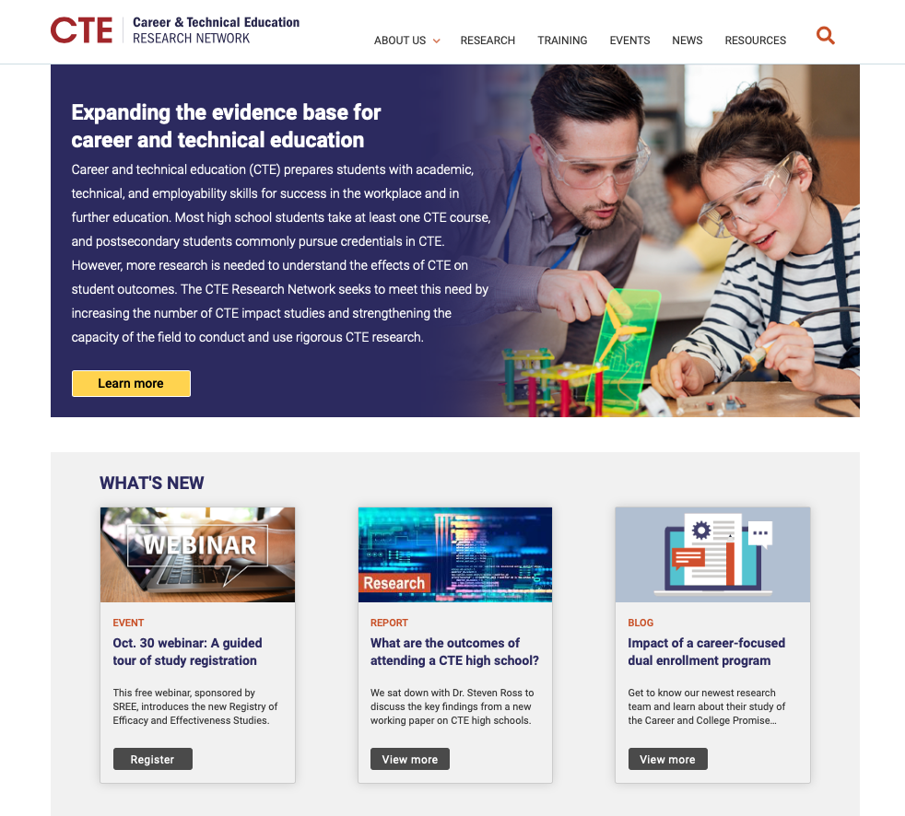
Connect with the Network!
Visit our website: https://cteresearchnetwork.org/
Follow us on Twitter and LinkedIn for news and updates
Sign up on the website for our mailing list
Email: CTEResearchNetwork@air.org

Slide 50
Questions?
https://www.google.com/url?sa=i&url=https%3A%2F%2Fwww.freepngimg.com%2Fpng%2F88494-emoticon-text-symbol-question-mark-free-clipart-hd&psig=AOvVaw13pPJmZssbZv91pzq03kli&ust=1604615240786000&source=images&cd=vfe&ved=0CAIQjRxqFwoTCPiK59736ewCFQAAAAAdAAAAABAI

Slide 51
THANK YOU!
Cherise Moore, PhD Principal Technical Assistance Consultant cmoore@air.org
Tara Smith
Associate Research Director
tsmith@jff.org
Pradeep Kotamraju, PhD
Dep. Director, Policy, Research and Legislation
Pradeep.Kotamraju@cwdb.ca.gov

Slide 52
Reflection and Opportunities
Red light: What is one question you still have?
Yellow light: What is one takeaway that you are figuring out how to apply?
Green light: What is one action step you will take based on what you learned today?

